Slide 1
Party A
Party B
Party A
Party B
Central counterparty
Party C
Party D
Party C
Party D

Slide 2
Day 1
Day 2
Day 3
Day 4
100 AAPL in account Sell AAPL @ $116.15
Buy F @ $12.59
Sell F @ $13.17
Funds from AAPL sale are received
922 shares in F
$7.02
$12,149.76
$11,615.00
freeriding
Day 1
Day 2
Day 3
Day 4
100 AAPL in account Sell AAPL @ $116.15
Buy F @ $12.59
No action
Funds from AAPL sale are received
Sell F @ $12.77
922 shares in F
$7.02
$11,780.96
$11,615.00

Slide 3
Alice’s account throughout the day
Clearing stage
£100
100 shares of A
£80 go out of Alice’s account
80 shares credited to her account
90 shares of A £10
80 shares of A £20

Slide 4
Blockchains | Best feature | Worst feature
 | Popularity | Poor performance
 | Security | Impractical
 | Performance | Poor security
 | Performance | Cost
 | Performance | Impractical

Slide 5
Regulator transaction{B, EX} transaction{A, B} transaction{B, C} transaction{A, EX}
Bank A transaction{A, B} transaction{A, EX}
Bank C transaction{B, C}
Bank B transaction{A, B} transaction{B, C} transaction{B, EX}
Exchange transaction{B, EX} transaction{A, EX}

Slide 6
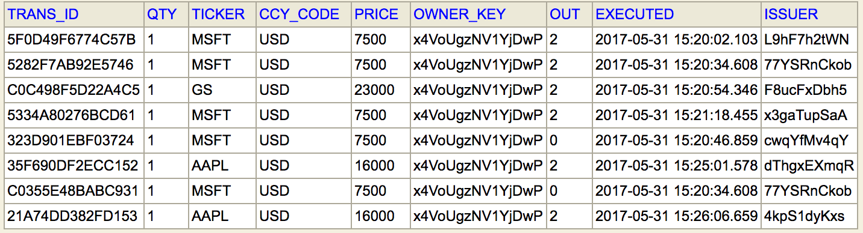
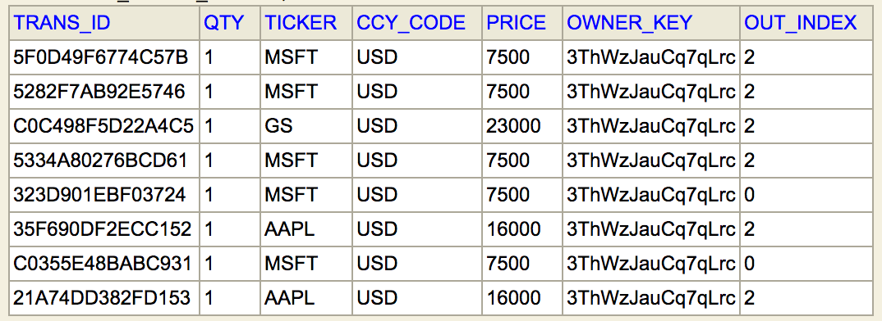
Share
trans_ID: String (PK) qty: Long
ticker: String currency: String
price: Long owner_key: String output_index: Int
execution_time: Instant issuer_key: String

Slide 7
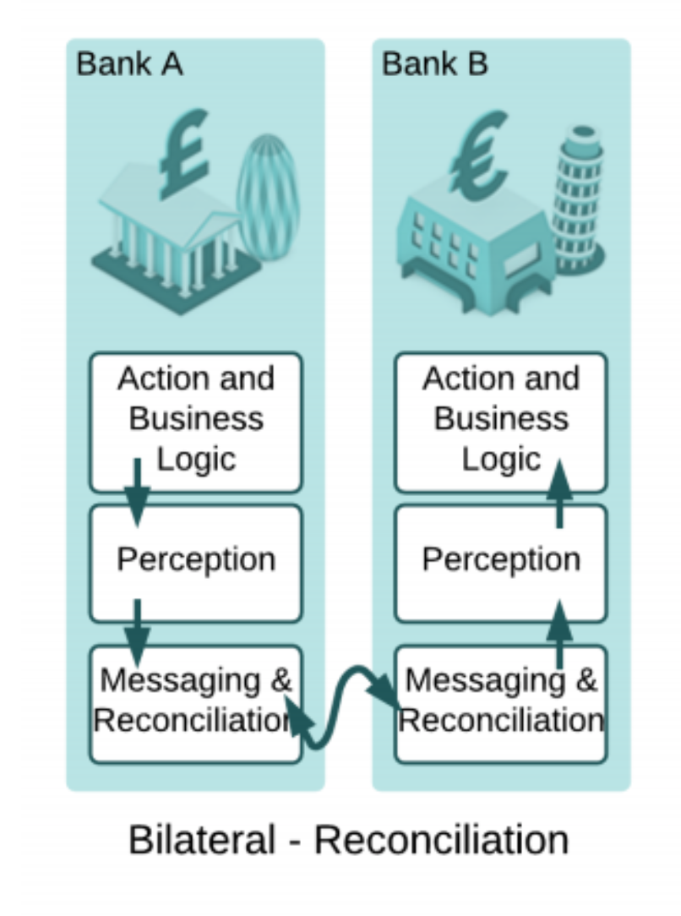
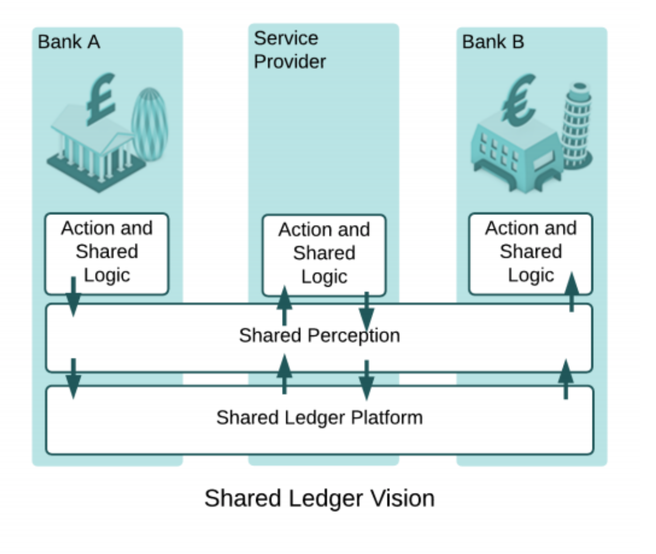

Slide 8
Bank A’s 💰💰💰
Bank A’s 💰💰💰
$600 (owned by Bank A)
$1000 (owned by Bank A)
$3500 (owned by Bank A)
$3500 (owned by Bank A)
Bank B’s 💰💰💰
$400 (owned by Bank B)
📄 (worth $400) owned by Bank B
📄 (worth $400) owned by Bank A

Slide 9
💰 Bank of Corda 💰
issue cash 💵
self-issue shares 📄
Bank A
(Buyer)
external broker communication
Bank B (Seller)

Slide 10
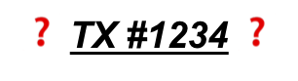
Bank A
Bank B (TX #1234)
TX #1234 ✅
Auditor
TX #1234 ✅
Bank D (TX #1234)
Bank C

Slide 11
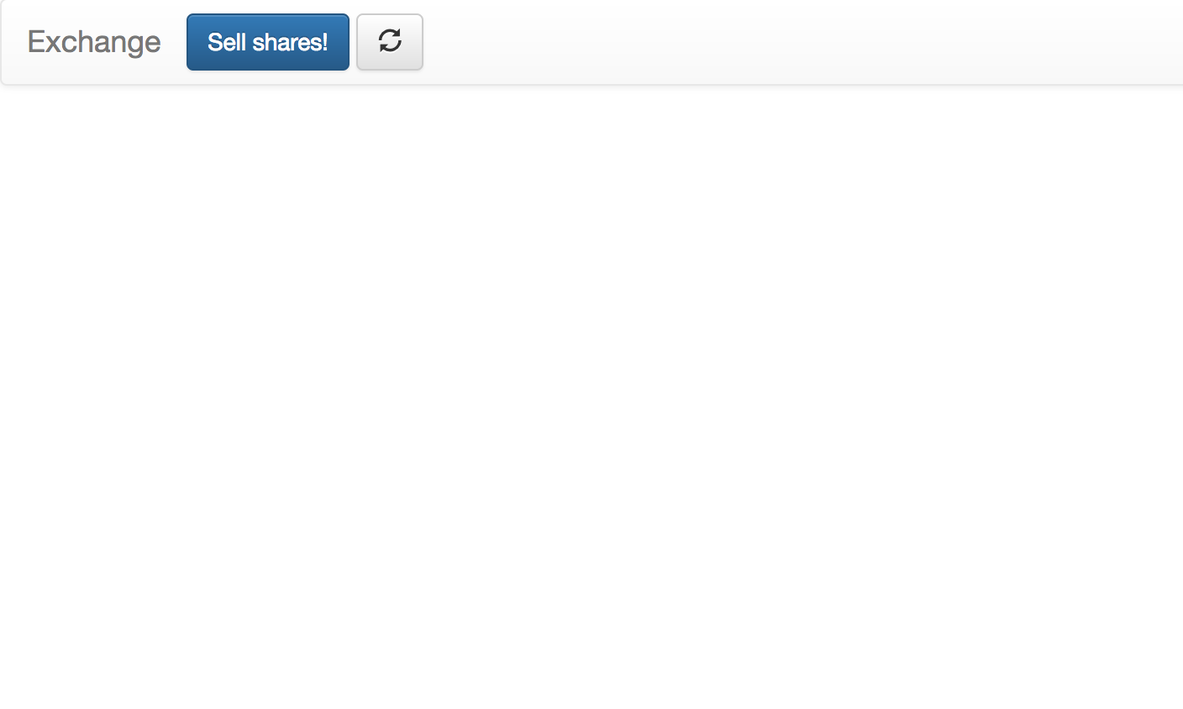
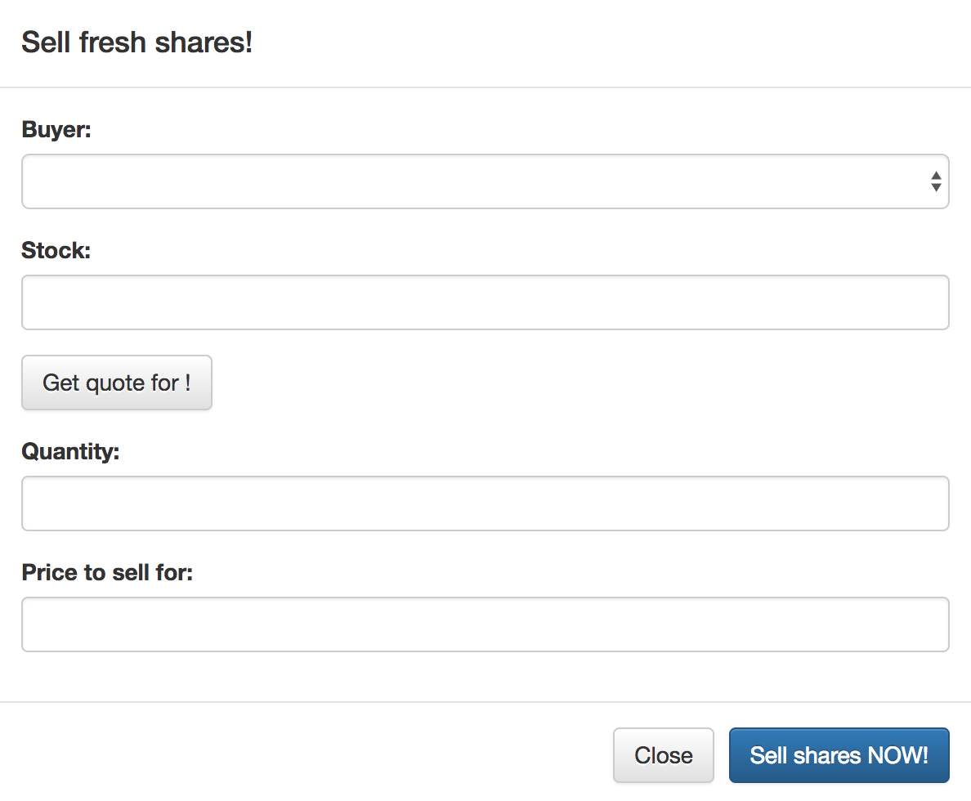

Slide 12
✅ Notary ✅
Bank A
💰
Hargreaves
📄💰
💰 Bank of Corda 💰
📄💰
Bank B
💰
Beaufort Securities
📄💰
📄
Bank C
💱 Exchange 💱
📄

Slide 13
Supernode A
Supernode B
Node A1
Node A2
Node A3
Node B1
Node B2
Node B3
Bank A
Bank A
Bank A
Bank B
Bank B
Bank B
Customer 1
Customer 2
Customer 3
Customer 4
Customer 5
Customer 6

Slide 14
Bank A
Bank B
Customer 1
Customer 2
Customer 3
Customer 4
Customer 5
Customer 6

Slide 15
Bank A
Bank B
Customer 1
Customer 2
Customer 3
Customer 4
Customer 5
Customer 6

Slide 16
Bank 1a
Bank Na
TX 1
TX N
Bank 1b
Bank Nb
We have n parallel transactions, happening between 2n nodes.

Slide 17
RAFT Cluster (many nodes)
Node Group A
Node Group B
Bank A
Bank B
Bank A
Bank A’s subsidiary
Bank B
Bank B

Slide 18
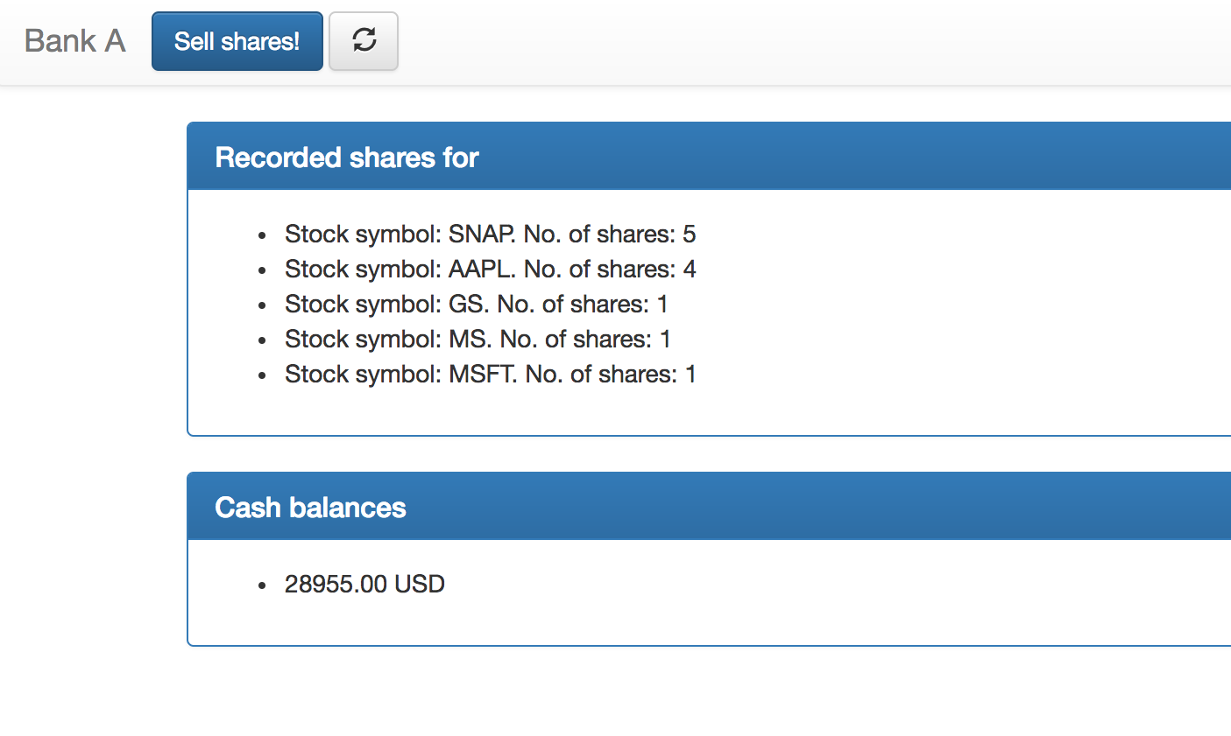

Slide 19
Notary services
Network map
Permissioning
TXs
storage
TLS certificates
AMPQ 1.0/TLS
Party A
Party B
Node A
Node A
CordApps
CordApps
vault
vault
TXs
TXs

